Slide 1
Everything Marketers Need to Know About Web Tracking Cookies
Krystle Solomon Marketing Automation Strategist & Privacy Champion, Sercante

Slide 2
Special Thanks To Our Sponsors
Title
Platinum
Gold
Silver

Slide 3
Agenda
Establishing Cookie Terminology & Types
Industry Pulse: What’s Changing & Why
What This Means For You & What’s Next

Slide 4
Establishing Cookie Terminology & Types

Slide 5
What is a Cookie?
A cookie is a small text file that a website places on your device while you are browsing.
They are processed and stored by your web browser.
In and of themselves, cookies are harmless but serve crucial functions for websites that can also generally be easily viewed and deleted.

Slide 6
What They Are Used For
Cookies are mainly used for three purposes:
Session Management
Logins, shopping carts, game scores, or anything else the server should remember
Personalization
User preferences, themes, and other settings
Tracking
Recording and analyzing user behavior

Slide 7
Types of Cookies
Duration
Session cookies
Persistent cookies
Purpose
Marketing cookies
Statistic cookies
Performance cookies
Functional cookies
Strictly necessary cookies
Source
First-party cookies
Third-party cookies

Slide 8
Types of Cookies
Duration (Session Management)
This category encompasses all cookies that remain on your hard drive until you erase them or your browser does, depending on the cookie’s expiration date.
Session cookies - are cookies that are deleted when a session ends.
Persistent cookies - are cookies that remain longer (even after a session ends).
All persistent cookies have an expiration date written into their code, but their duration can vary. According to the ePrivacy Directive, they should not last longer than 12 months, but in practice, they could remain on your device much longer if you do not take action.

Slide 9
Types of Cookies
Purpose (Personalization)
These cookies will generally be first-party session cookies.
Preference cookies (also known as “functional cookies”) - these cookies allow a website to remember choices you’ve made in the past, like what language or region you prefer or what your username and password are so you can automatically log in.
Strictly necessary cookies - These cookies are essential for you to browse the website and use its features, such as accessing secure areas of the site.
While it is not required to obtain consent for these cookies, what they do and why they are necessary should be explained to the user.

Slide 10
Types of Cookies
Purpose (Personalization & Tracking)
Statistics cookies - these cookies collect information about how you use a website, like which pages you visited and which links you clicked on.
None of this information can be used to identify you as their sole purpose is to improve website functionality.
Marketing cookies - these cookies track your online activity to help advertisers deliver more relevant advertising or to limit how many times you see an ad.
Because these cookies can share information with other organizations or advertisers they are and have been almost always of third-party origin.

Slide 11
Types of Cookies
Source (Personalization & Tracking)
Set by websites to store user preferences and track behavior
First-party cookies - are put on your device directly by the website you are visiting. These cookies often store information that is relevant or related to the site, such as preferred settings or user location.
Third-party cookies - are the cookies that are placed on your device, not by the website you are visiting, but by a third party like an advertiser or an analytic system (like Marketing Cloud Account Engagement).

Slide 12
Industry Pulse: What’s Changing & What Isn’t

Slide 13
Why Things are Changing
*Cookies can store a wealth of data - enough to potentially identify users without their consent.
*Cookies are the primary tool that advertisers use to track online activity so that they can target users with highly specific ads.
*Given the amount of data that cookies can contain, they are considered personal data in certain circumstances and, therefore, subject to privacy laws such as the EU GDPR.
*The EU GDPR and the EU ePrivacy Directive both regulate the use of cookies and lists "cookie identifiers" as an example of personal information.

Slide 14
Why Things are Changing
When people complain about the privacy risks presented by cookies, they are generally speaking about “third-party,” “persistent,” and “marketing” cookies.
These cookies can contain significant amounts of information about someone’s online activity, preferences, and location.
The chain of responsibility (who can access a cookies’ data) for a third-party cookie can get complicated as well, only heightening their potential for abuse. It is likely because of this, the use of third-party cookies has been in decline since the passage of the GDPR.

Slide 15
What is Changing
Google Chrome, who represents 60% of the market share, has begun to limit insecure cross-site tracking (cookies that don’t include a SameSite label as first-party but are labeled for third-party use must be accessed over HTTPS) as of February 2020, and by the end of 2024 third-party cookies are said to be made obsolete.
After this point, B2B, B2C companies and individual website creators who collect and process website user data will no longer be able to do so via third-party cookies.
These entities will need to become “Cookie Compliant” under new privacy changes and collect, track and process user information via first-party cookies.

Slide 16
What This Means For You

Slide 17
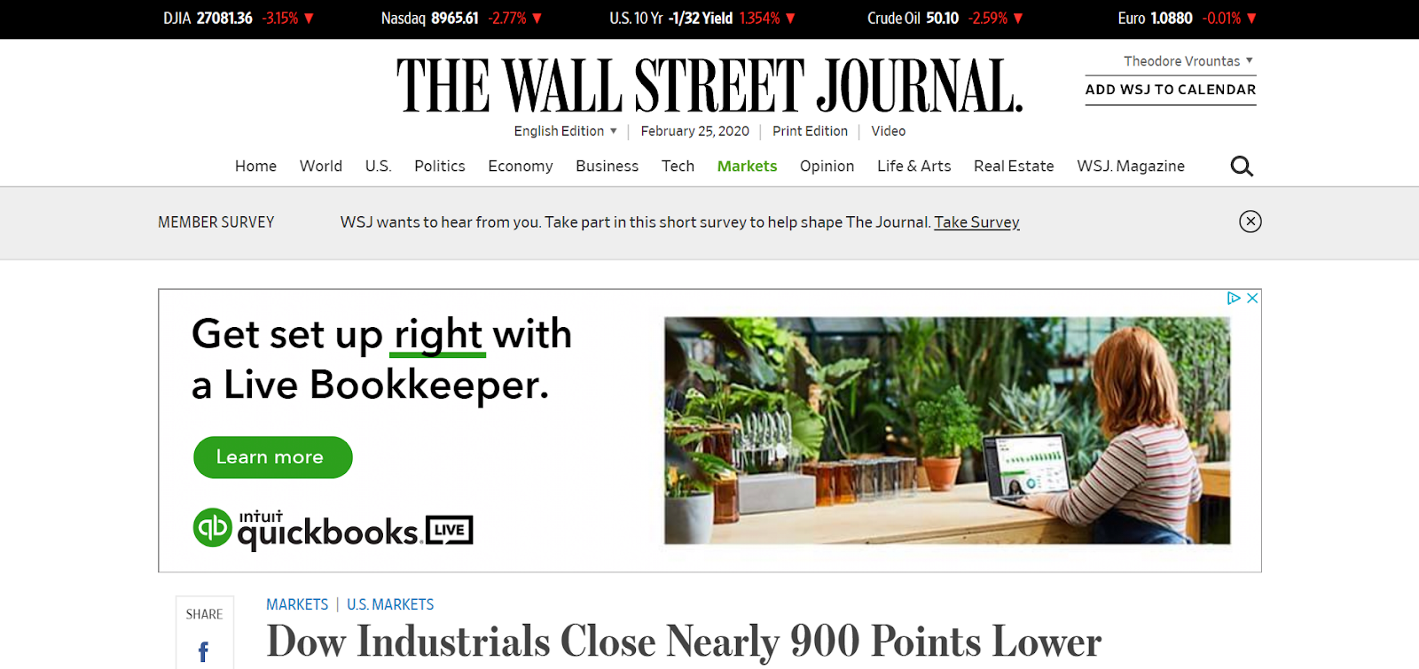
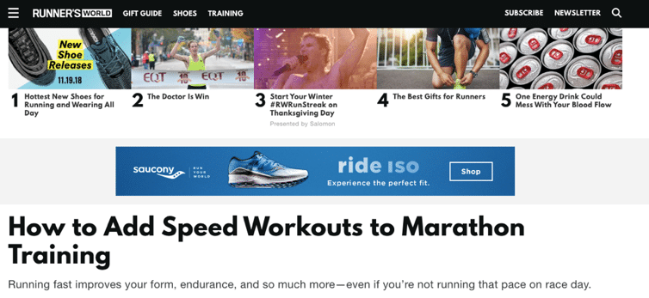
What Does this Mean for You?
Publishers, digital advertisers, and brands should rethink how they currently track online behavior today.
In the absence of cookies, contextual advertising will become “the new cookie” for many advertisers, providing relevance to consumers who are increasingly concerned they are being listened to or followed by cookie-based behavioral targeting.
Think: placing an ad for Quickbooks on a finance blog or an ad for running shoes on a running forum.

Slide 18
Contextual Targeting is where the cookie conversation is headed and trend reports have shown a 60% positive sentiment from consumers towards brands when ads that appear are more relevant.

Slide 19
Additional Steps To Take
Set aside time to audit your current website, CRM & MA systems to ensure you are prepared for these changes
Enable First-Party Tracking and
Force HTTPS in your MA account settings
Consider investing in a cross-device platform to give you a 360-view of your customer

Slide 20
Become Cookie Compliant
GDPR
Receive users’ consent before using any cookies (except strictly necessary cookies)
Provide accurate and specific information about the data each cookie tracks and its purpose in plain language before consent is received
Document and store consent received from users
Allow users to access your service even if they refuse to allow the use of certain cookies
Make it as easy for users to withdraw their consent as it was for them to give it
CCPA/CPRA
Prominently display a link to a "Do Not Sell (or Share) My Personal Information" page on each webpage where third-party cookies are set.

Slide 21
What’s Next

Slide 22
What’s Next
Google is working through their Privacy Sandbox initiative to develop advertising methods that protect users’ privacy but enable some form of focused targeting.
Google Topics, an API based solution, replaces the previous proposal of a Federated Learning of Cohorts (FLoC) as the latest interest-based advertising privacy solution.
Google has advised that different advertisers will be served different “topics” from the same individual through the API in an attempt to protect anonymity.

Slide 23
New Technologies
There is an industry-wide effort, such as the non-profit consortium started by IAB and IAB Tech Lab called Project Rearc, to develop a less invasive alternative to third-party cookies that enables advertisers to still target users with relevant content, but maintains a high degree of consumer privacy.
The Trade Desk’s Unified ID 2.0 is also gaining traction by building upon an open source ad ID framework.
Individual providers like Tapad have introduced new solutions like Switchboard that will increase the utility and value of the cookieless ID space in conjunction with other addressable IDs, including Unified ID 2.0, by providing a layer of connectivity that will be natively missing with the deprecation of third-party cookies. *Source: InMarket InSights Crumbling Cookies

Slide 24
What’s Next
While there has been no further progress on the ePrivacy regulation (a replacement of the EU ePrivacy directive) other EU digital legislations are gaining ground such as the Digital Services Act - which seeks to hold search engines, social media networks, and marketplaces accountable for policing content on their sites.
The rules regulating cookies are still being set, and cookies themselves are continually evolving, which means maintaining a current cookie policy will be a continuous job.
However, properly informing your users about the cookies your site is using and receiving their consent will keep you compliant and mitigate data subject complaints.

Slide 25
Disclaimer
This presentation is general and educational in nature and is not intended to provide, and should not be relied on, as a source of legal advice. The information and materials provided may not be applicable in all (or any) situations and should not be acted upon without specific legal advice based on particular circumstances.

Slide 26
Krystle Solomon
krystle@sercante.com

