Slide 1
Panel: Exploring B2B Marketing Trends
and Best Practices With Marketing Cloud Account Engagement

Slide 3
Goal of Panel
Learn how our panelists have built and put into play dynamic processes in their organizations using Marketing Cloud Account Engagement (Pardot) to improve their B2B Marketing. In this session, we will also explore Pardot’s newest features and how to use them within your own organization to maximize your output.

Slide 4
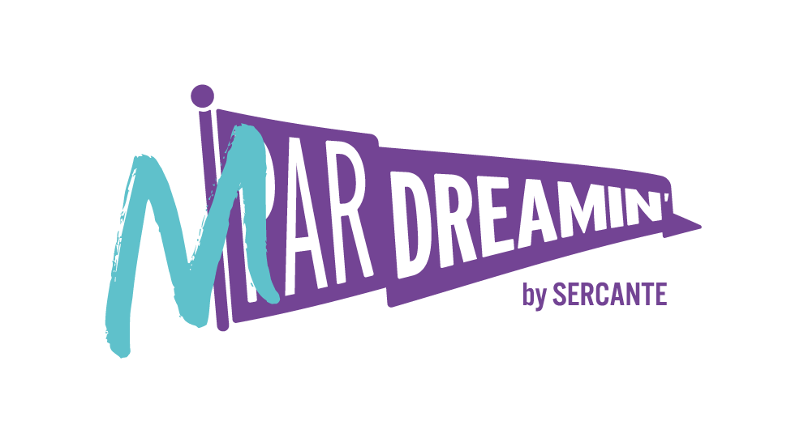
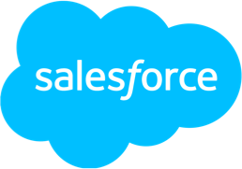
Special Thanks To Our Sponsors
Title
Platinum
Gold
Silver

Slide 5
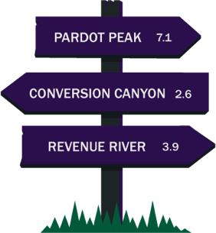
Host
Jen Kazin
Founder Greenkey

Slide 6
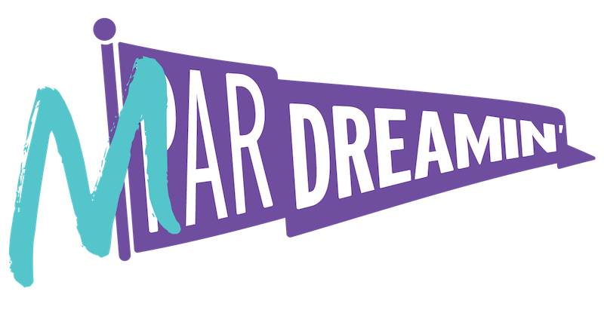
Introductions
Tell us about your role
Notes:
Everyone

Slide 7
Panelists
Ruth Bolster
Product Marketing Manager, Account Engagement (Pardot) Salesforce
Erin Duncan
Pardot Product Director Sercante
Natalie Jackson
Director, Demand Generation CBIZ

Slide 8
Question 1
What are two of your favorite Account Engagement features and why should customers use them?
Notes:
Natalie and Erin

Slide 9
Question 2
How is your organization leveraging Account Engagement in order to maximize operational efficiency?
Notes:
Natalie

Slide 10
Question 3
What is your take on external activities? How do you think customers should use them?
Notes:
Erin / Ruth

Slide 11
Question 4
What is one B2B Marketing trend you think we will start to see more of in 2023?
Notes:
Jen / Ruth

Slide 12
Question 5
What is one thing you took away from yesterday's Marketing Cloud roadmap session?
Notes:
Erin / Natalie

Slide 13
Question 6
What is the most interesting way you have seen Account Engagement be used?
Notes:
Erin / Jen

Slide 14
Resources
The Spot
The Spot is a community resource for marketers whose tech stacks include Salesforce clouds and tools. It’s where you can go to get everything you need to build next-level martech solutions that feed into the Salesforce platform while equipping others to do the same.
Come here for:
Blogs on MarTech (CRM Analytics, Marketing Cloud, Salesforce, Pardot, Strategy, etc)
Community on Slack
Career Opportunities
Greenkey Digital Blog
The Greenkey Digital blog is by Jen Kazin. Join her as she explores the latest features of pardot and also provides helpful deep-dives on other feature found in the platform.
Come here for:
Blog on Account Engagement
Office Hours
Trailhead
Learn in-demand skills, earn resume-worthy credentials, and connect with a community of Trailblazers for mentorship and employment opportunities. The platform breaks down barriers to learning and creates an equal and accessible pathway into the Salesforce ecosystem for anyone with an internet connection.
Come here for:
Training Modules
Certification Prep
Community Forums

Slide 15
Live Q&A

Slide 16
Coming Up Next…
Marketing Cloud Journey Builder: Design And Build Custom Journeys
12:05 PM EST
How To Bring Pardot Capabilities Into Salesforce Flow
12:05 PM EST
The Future Of Personalization In Marketing (using Salesforce CDP)
12:05 PM EST

Slide 17
Special Thanks To Our Sponsors
Title
Platinum
Gold
Silver

